Slide 1
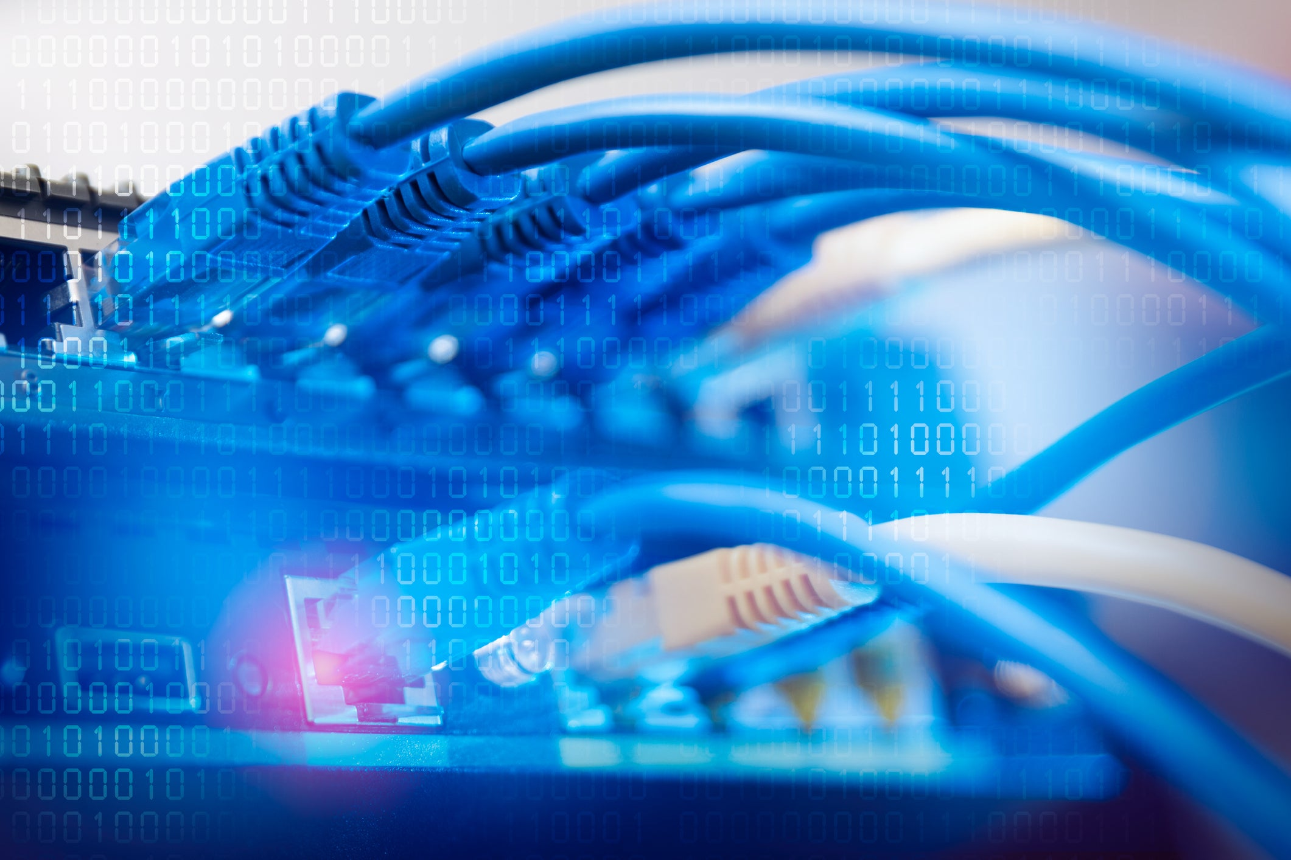
PROJECT Implementation of Remote Access Methods for Network Devices
-
Siddhant Gahtori
https://github.com/imsiddhant/

Slide 2
Concepts Used In this Project
I. Campus Area Network
II. VLAN
III. Etherchannel
IV. Router on A Stick
V. Switch Virtual Interfaces
VI. Telnet
VII. SSH
VIII.OSPF
IX. DHCP & DNS

Slide 3
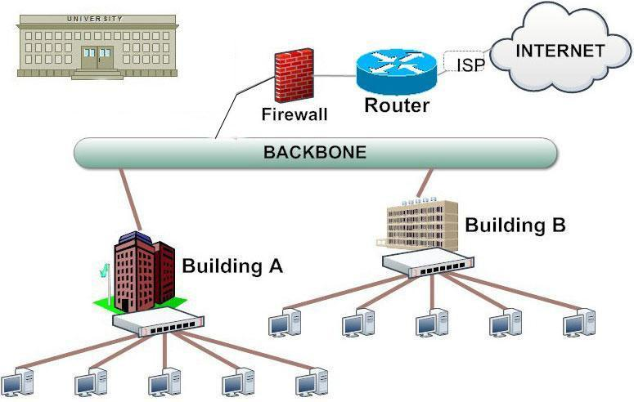
I. Campus Area Network
A campus network, campus area network, corporate area network or CAN is a computer network made up of an interconnection of local area networks (LANs) within a limited geographical area.The networking equipments (switches, routers) and transmission media (optical fiber, copper plant, Cat5 cabling etc.) are almost entirely owned by the campus tenant / owner: an enterprise, university, government etc.

Slide 4
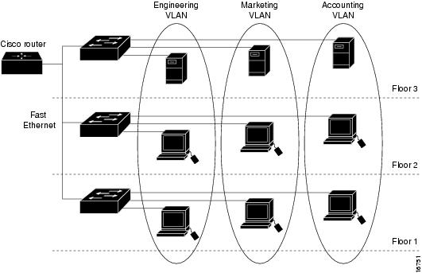
II. VLAN
A VLAN is a group of devices on one or more LANs that are configured to communicate as if they were attached to the same wire, when in fact they are located on a number of different LAN segments. Because VLANs are based on logical instead of physical connections, they are extremely flexible.
VLANs define broadcast domains in a Layer 2 network.

Slide 5
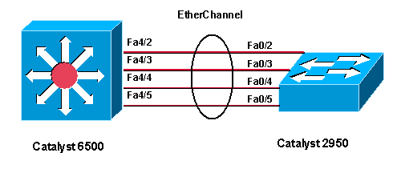
III. Etherchannel
EtherChannel is a port link aggregation technology or port-channel architecture used primarily on Cisco switches.
It allows grouping of several physical Ethernet links to create one logical Ethernet link for the purpose of providing fault-tolerance and high-speed links between switches, routers and servers.

Slide 6
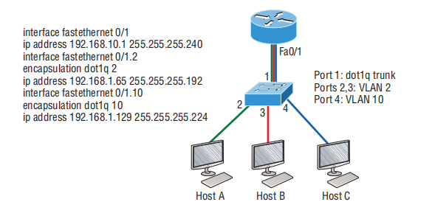
IV. Router on A Stick
Router-on-a-stick (ROAS) is a feature that allows us to route packets to subnets associated with VLANs connected to a router 802.1Q trunk. It uses a router VLAN trunking configuration to give the router a logical interface connected to each VLAN.
ROAS is usually used in small to medium sized organizations that wants to implement inter-VLAN routing.

Slide 7
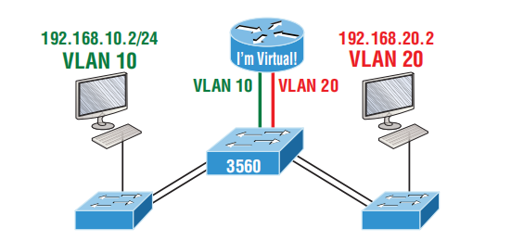
V. Switch Virtual Interfaces
A Switch Virtual Interfaces (SVI) represents a logical Layer 3 interface on a switch.
VLANs divide broadcast domains in a LAN environment. Whenever hosts in one VLAN need to communicate with hosts in another VLAN, the traffic must be routed between them. This is known as inter-VLAN routing. On Layer 3 switches it is accomplished by the creation of Layer 3 interfaces (SVIs).

Slide 8
VI. Telnet
VII. SSH
Telnet is an application protocol used on the Internet or
local area network to provide a bidirectional interactive text-oriented communication facility using a virtual terminal connection. User data is interspersed in band with Telnet control information in an 8-bit byte oriented data connection over the Transmission Control Protocol (TCP).
Secure Shell (SSH) is a cryptographic network protocol for operating network services securely over an unsecured network.
Typical applications include remote command-line, login, and remote command execution, but any network service can be secured with SSH.

Slide 9
VIII.OSPF
Open Shortest Path First (OSPF) is a link-state routing protocol which is used to find the best path between the source and the destination router using its own Shortest Path First). OSPF is developed by Internet Engineering Task Force (IETF) as one of the Interior Gateway Protocol (IGP), i.e, the protocol which aims at moving the packet within a large autonomous system or routing domain. It is a network layer protocol which works on the protocol number 89 and uses AD value 110. OSPF uses multicast address 224.0.0.5 for normal communication and 224.0.0.6 for update to designated router(DR)/Backup Designated Router (BDR).

Slide 10
IX. DHCP & DNS
Dynamic Host Configuration Protocol (DHCP) enables users to dynamically and transparently assign reusable IP addresses to clients.
Cisco IOS Easy IP Phase 2 includes the Cisco IOS DHCP Server, a RFC 2131-compliant DHCP server implementation on selected routing platforms.
Domain Name System (DNS) is the system in the Internet that maps names of objects (usually host names) into IP numbers or other resource record values.
The name space of the Internet is divided into domains, and the responsibility for managing names within each domain is delegated, typically to systems within each domain.

Slide 11
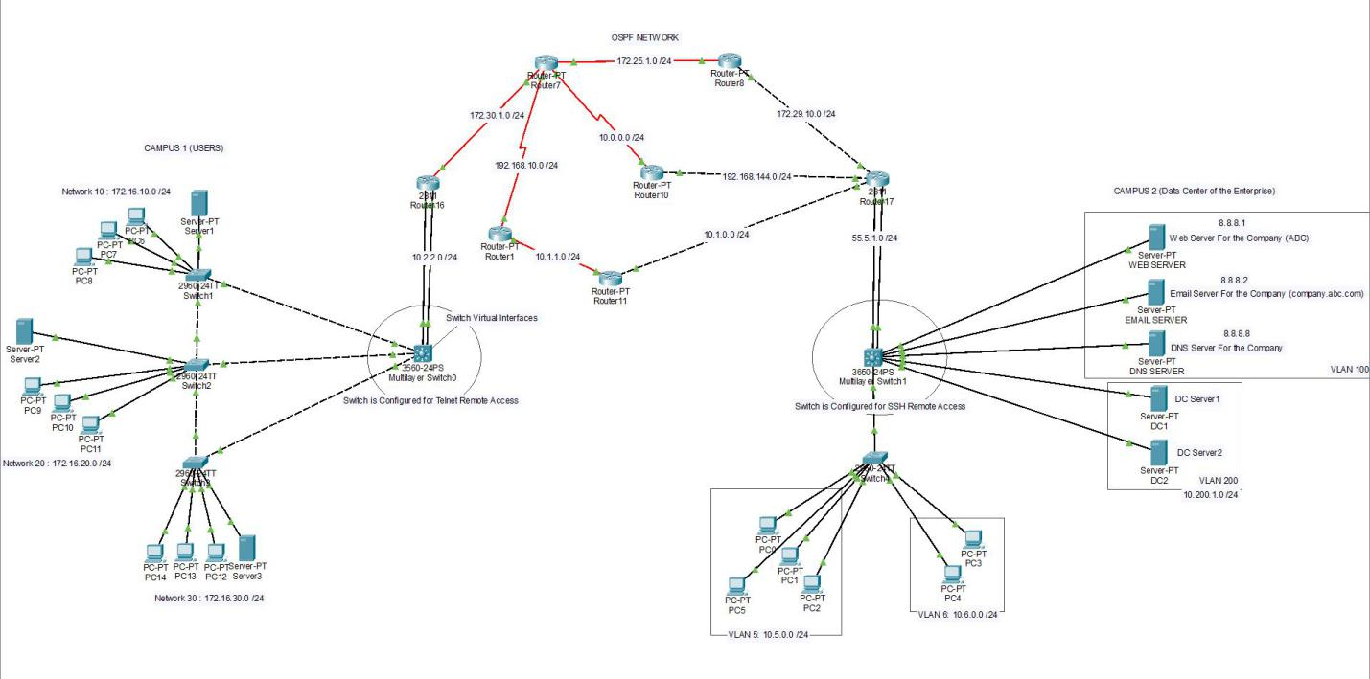
SCREENSHOT OF THE PROJECT

Slide 12
THANK YOU! SIDDHANT GAHTORI

